Slide 1
Excel – Spreadsheet 試算表
Tip #1:
equation always starts with an “=” symbol
公式必須由“=”開始
=SUM(A1:B5)
✅→
Tip #2:
No space around the “function name”
公式函數名稱不可有“空白”
= SUM (A1:B5)
↑
❎
↑
❎
https://youtu.be/ZaZziIZiD20?list=PLQutejmQFO79b_NfuHGDl_4d-wZ2rr_h0
Tip #3:
“Upper” case = “Lower” case
“大楷” = “小楷”
=sum(a1:b5)
✅→

Slide 2
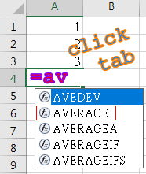
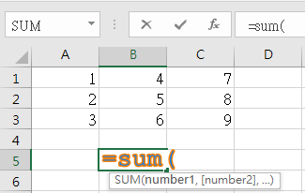
Excel – Spreadsheet 試算表
Tip #4:
Select from the “suggested list”
由 “建議清單” 中選取
=AVERAGE…
↓
tab
Dbl Click →
Tip #5:
“click” or “click and drag”
“點按” 或 “點按+拖拉”
=SUM(A1,B1,C1, A2,B2,C2)
=SUM(A1:C2)


Slide 3
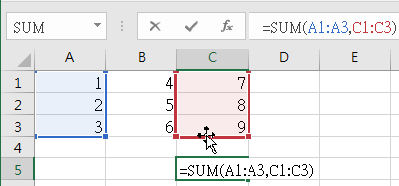
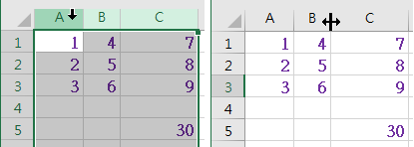
Excel – Spreadsheet 試算表
Formula Bar
公式欄
Click
↓
Tip #6:
“modify” equation
“改變” 公式
…
✗ ✓
Drag →
↓→
↓
Tip #7:
Select “columns”
選取 “欄”
Resize “col width”
改變 “欄寛”

Slide 4
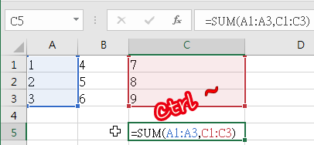
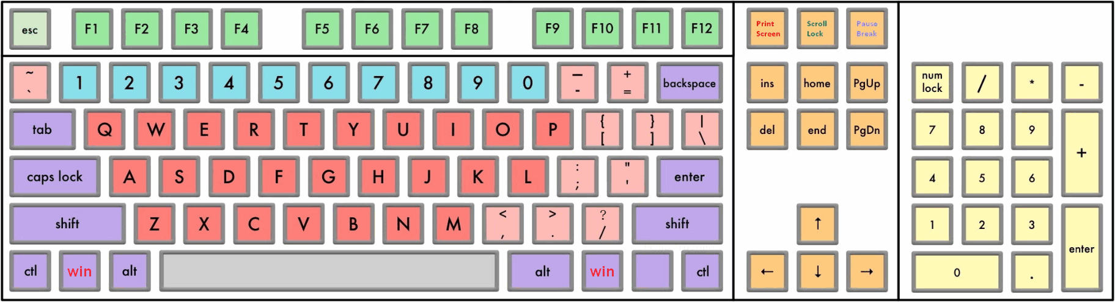
Tip #8:
Press “Ctrl ~” (show equation/value)
按 “Ctrl ~” (顯示 公式/數值)
=SUM(A1:A3,C1:C3)
30
30
Tip #9:
Enter +,-,*,/ using “Keypad”
利用 “數字鍵盤” 輸入 +,-,*,/
=(A1+B1+C1+D1)*10

Slide 5
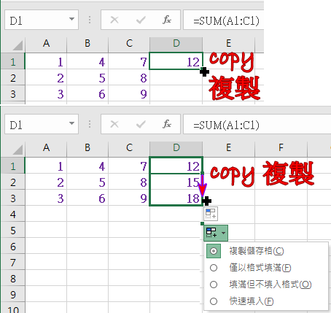

Tip #10:
“Copy equation”
“複製公式”
=SUM(A1:C1)
=SUM(A2:C2)
=SUM(A3:C3)
Tip #11:
“Ctrl-Z”
Undo 復原
↓
⭯

Slide 6
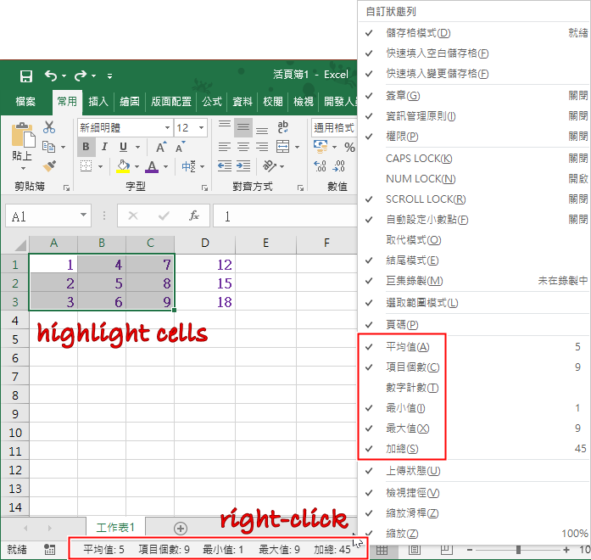
Tip #12:

Slide 7
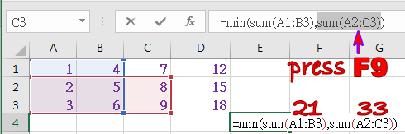
Excel – Spreadsheet 試算表
https://kknews.cc/zh-hk/tech/a86e6yx.html
Tip #13:
“F9”
=MIN(SUM(A1:B3),SUM(A2:C3))
✗ ✓
Tip #14:
Shortcut keys 快速鍵
“Ctrl-PgUp”, “Ctrl-PgDn”
“Ctrl-Home”, “Ctrl-End”

Slide 8
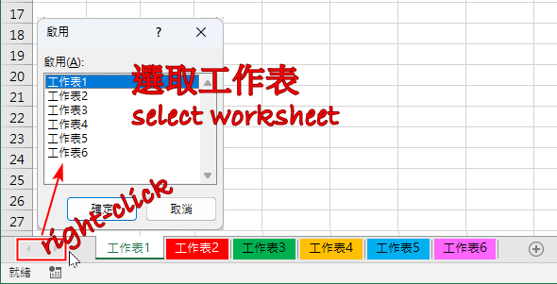
Excel – Spreadsheet 試算表
Tip #15:
Select “worksheet”
選取 “工作表”

Slide 9
END

