Slide 1

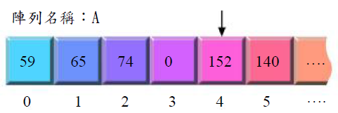
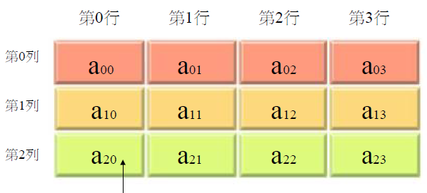

Slide 2
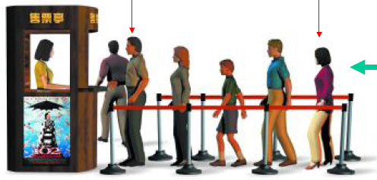
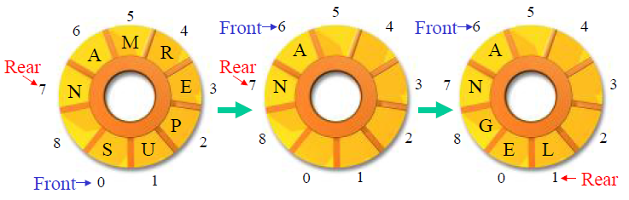

Slide 3
 | 資料結構 | 優點 | 缺點
1 | 陣列 (Array) | 沒有額外變量 (例head, next,...) 運作/操作較簡單 | 更新資料時，若要保持順序，需要移動較大量資料 靜態結構Static (宣告時已決定了陣列元素多少，不能在程式執行期間增減元素)
2 | 隊列Queue (FIFO) | 容易更新 加入enqueue: 隊尾tail 移除dequeue: 隊首head | 需要額外變量head / tail
3 | 堆疊Stack (LIFO) | 容易操作 加入Push移除Pop皆在頂部stack top進行 | 需要額外變量top
4 | 鏈表Linked List | 加新或移除資料時，只需改動少量資料，仍能保持順序 動態結構Dynamic (程式執行期間，可隨意增減元素) | 需要額外變量head, next 運作/操作較複雜(搜尋、更新)
2D Array: 98Queen, 00, 06, 08, 09
Stack 05, 06
LList: 94, 07, 08, 09
Queue

Slide 4
 |  | #define N 100
1 | Linear Ordered List (Array) | char List [N] [10];
2 | Queue (FIFO) | char Queue [N] [10]; | int Head, Tail;
 | Circular Queue Priority Queue
3 | Stack (LIFO) | char Stack [N] [10]; | int Top;
4 | Linked List | char LList [N] [10]; int Next [N]; | int Head;
 | Doubly Linked Lists
5 | Binary Tree
6 | DiGraph
7 | Heap
8 | Hash Table

Slide 5
http://www.apsu.edu/myersb2/linked_list_animation.htm
http://www.cs.stir.ac.uk/~mew/dissertation/
http://www.apl.jhu.edu/Classes/605202/felikson/lectures/L3/L3.html
http://www.eecg.toronto.edu/~jayar/courses/aps105S/quizzes/quiz2b/node2.html
http://www.theparticle.com/javadata2.html
 | Data Structure | Advantages | Disadvantages
1 | Linear Ordered List (Array) | No additional storage is required Simple in operation | Large overhead for updating (i.e. shifting of elements up or down the list) Static (elements cannot be added at run-time)
2 | Queue (FIFO) | Easy to update Enqueue at the tail of Queue Dequeue at the head of Queue | Additional storage is required i.e. Head / Tail
3 | Stack (LIFO) | Push and Pop operation are always performed at the Stack Top | Additional storage is required i.e. Top
4 | Linked List | Insertion and Deletion are easier than those of a Linear List Dynamic (nodes can be added or removed at run-time) | Additional storage is required i.e. Head, Link to next node More complex algorithm is required for searching and updating is used

